Slide 1
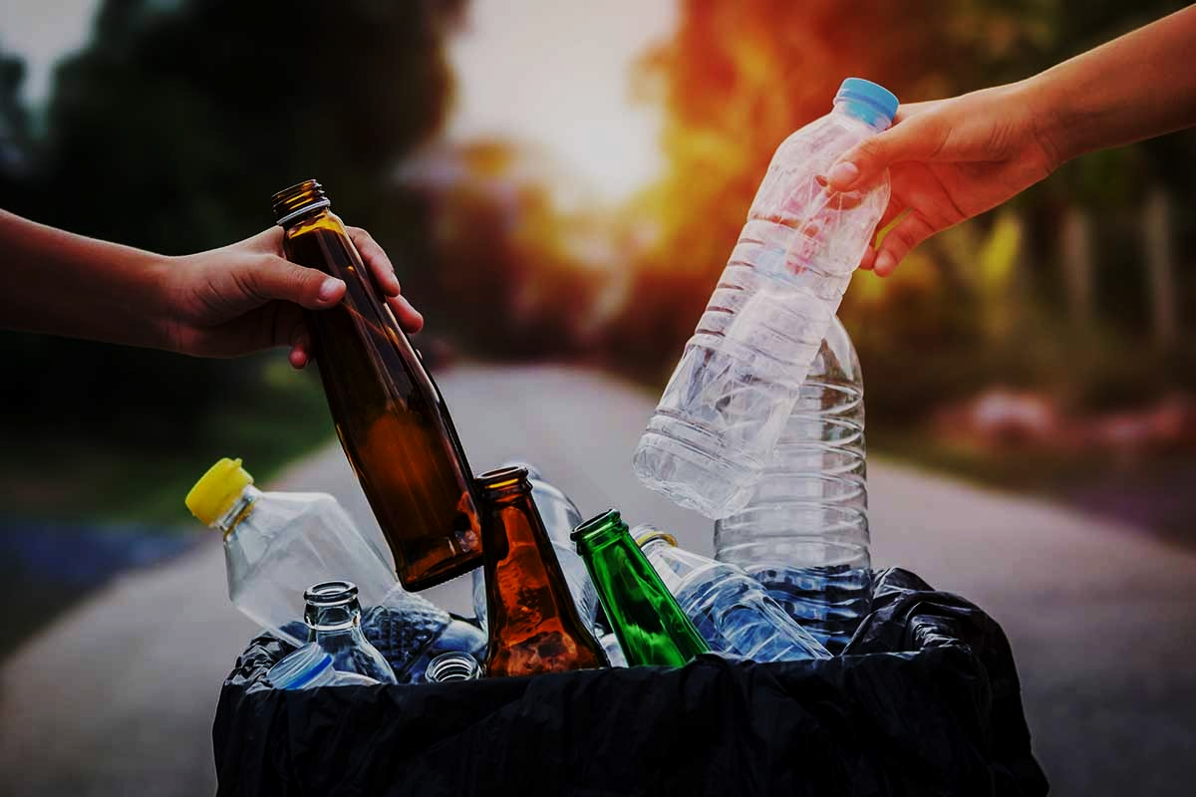
SQUANDER
CAPSTONE PROJECT
- FALL 2022
PROF HENRY WONG
Aakansha Agarwala
Austin Blaise
Nicholas Wong
Rajat Nagavkar
Suryadeep Nallana

Slide 2












AGENDA
Team Members
Product Backlog
Project Overview
Sprint Backlog
Personas
Retrospective
Technologies
Future Sprint
Design Architecture
Project Demo
Sprint Overview
Conclusion

Slide 3

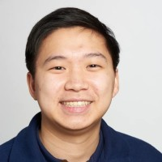
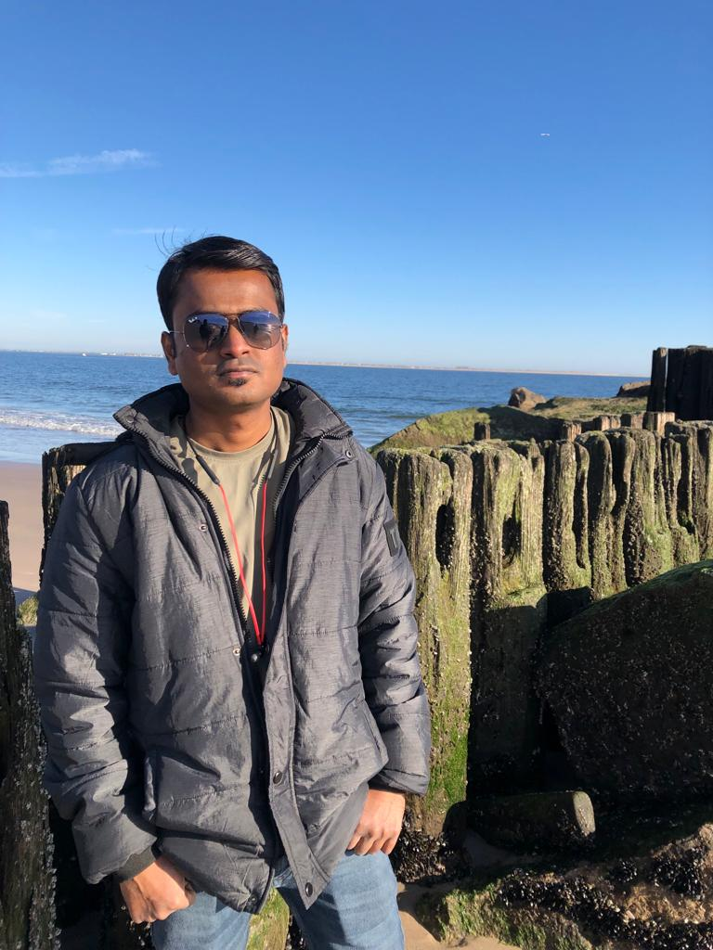
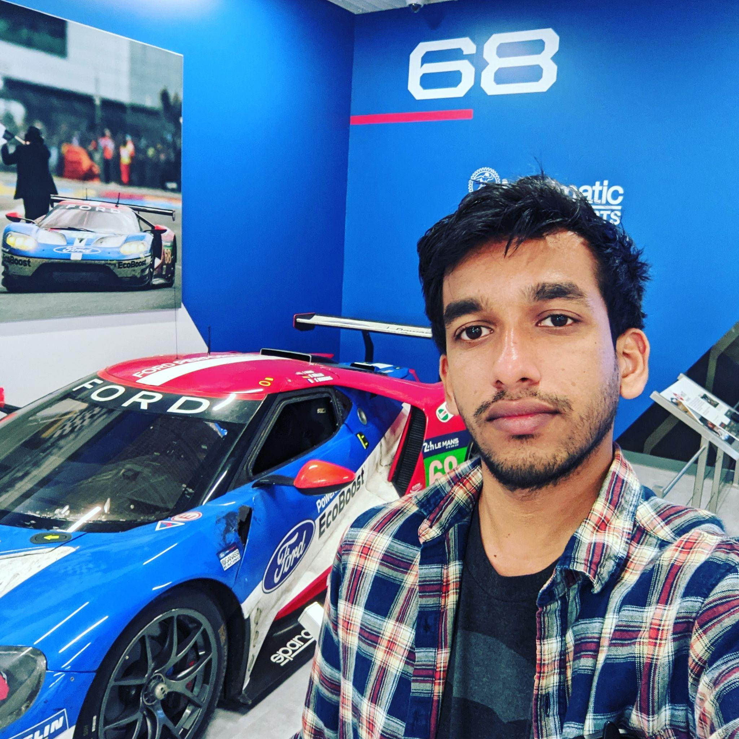
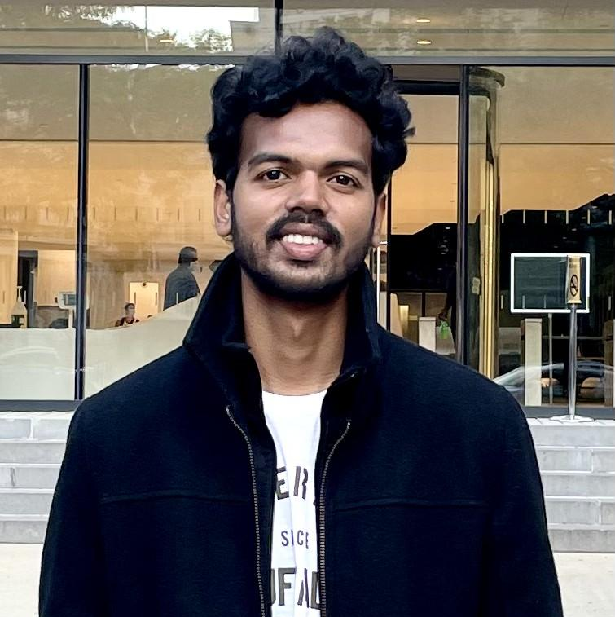
TEAM MEMBERS
ROLES & RESPONSIBILITIES
Aakansha Agarwala: Project Manager/Scrum Master
1. Led team meetings and kept the team on task
2. Maintains the project’s GitHub repository and Wiki
3. Documented test cases and co-authored technical paper
Nicholas Wong: Machine Learning Engineer
1. Design Computer Vision Model Architecture
2. Train and Evaluate Model Performance
3. Gather representative image data for training
Austin Blaise: Cloud Engineer
1. Contribute to the architecture of the project
2. Creates Infrastructure as code
3. Integrated features and services
Rajat Nagavkar: Ios Developer
1. Design and Development of Application.
2. Integrating ML model to provide specified results.
3. Testing the app to provide a better user experience.
Suryadeep Nallana: FullStack Developer/Quality Analyst
1. Contribution to design and development of the app layout
2. Authored technical document of the project
3. Working towards making our app user-friendly

Slide 4

PROJECT OVERVIEW

Slide 5

PROBLEM STATEMENT
As the population is increasing the amount of waste produced is also increasing.
The world produces 2.01 billion tons of urban solid waste yearly, with the United States being the highest producer of waste.
Most of the waste produced remains unprocessed due to a lack of recycling knowledge.
Squander app overcomes this problem by providing a way for waste recycling through a machine learning platform.

Slide 6
PROJECT DESCRIPTION
Squander app provides a complete solution to organize and plan the disposal of waste. It uses a machine learning algorithm to detect recyclable waste from images and provide proper disposal.
Squander app is an Image-based Waste detection mobile application.
The app works with an image submission by the user and a trained machine learning-based model runs on the image which gives results and information about that image.
As Squander is an image-based application, it’s an easy tool to detect waste by underlying simple steps in the application.
And the application also has a feature that provides the nearest recycling location with an option to schedule a pick of your waste by the recycling factory

Slide 7

PERSONA

Slide 8

Jill, the party host
Background Profile:
Jill, a 32-year-old. He is an event organizer of a well-reputed company in the city. He has organized many big parties and is always busy with his job. He takes all the responsibility and his duties also include providing a good food service. He gets many clients, particularly for the food he provides. His organization is popular among the people Jill does many parties and he collected more food waste by the end of the party. Jill would like to know the waste identified from the image uploaded so that he can confirm the photo he uploaded was processable.
How can Squander help?
Jill being responsible for organizing the party. He wants to recycle all the waste by segregating in rightful manner and help the surrounding environment. He can use an application. Squander which provides his needs by showing the results of nearest recycling company location for all the food waste from his parties that happen wherever in the city. Squander makes an efficient and easiest way in someone’s life like Jill’s

Slide 9
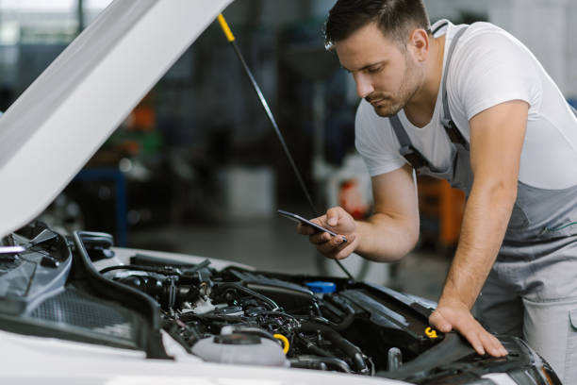
Simon, the mechanic
Background Profile:
Simon is a mechanic for ten years. His age is of 35 years. His jobs is to inspect and repair vehicles, machinery, and light trucks. And he is known for his good service providing for his customers. He works in an indoor garage. Simon’s culminated with metallic waste from his work and he wants to find a recycling location to recycle it and make some money from scrap
How can Squander help?
Simon can use the Squander application that helps him to find the nearest recycling company location for the waste to recycle from the comfort of his garage. This would allow him to find and provide easy access directly to the recycling company. He doesn’t have to worry about the waste and where to recycle it. Through Squander it makes his life easier.

Slide 10

David, the retiree
Background Profile:
David was a sale executive in a marketing firm. He retired from the job recently. He was successful and has been an inspiration for others in the company. After his retirement, David brought up the interest he had for quite some time to renovate his house. He wants to give a personal touch to the house and lead the rest of his life happily in his way. Now he is spending all his time taking care of the process under his supervision and making a beautiful house for himself
How can Squander help?
Squander can be helpful for David, as he is looking after the construction works for his house. The waste can generate a lot, with all the accumulated waste, he can recognize the waste under categories within the app and send it to his nearest garbage station. That’s make David being responsible for his waste and keeping the environment at a better position.

Slide 11

MINIMAL VIABLE PRODUCT

Slide 12
MINIMAL VIABLE PRODUCT (MVP)
Features:
Scheduling the pick up of recycling waste by the factory
Creation of a User Profile for each user who uses the application
Showing the History of a pickup that is scheduled by a user
Showing the recycling statistics for each user

Slide 13

TECHNOLOGIES

Slide 14







TECHNOLOGIES USED
AWS Cloudformation

Slide 15

ARCHITECTURE DESIGN

Slide 16
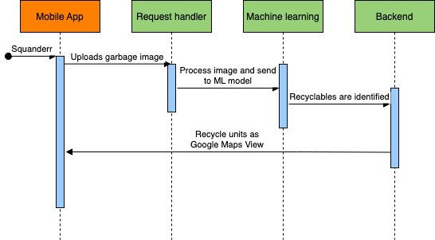
SQUANDER SEQUENCE DIAGRAM
Notes:
Need to update it with a sequence diagram and flow diagram

Slide 17
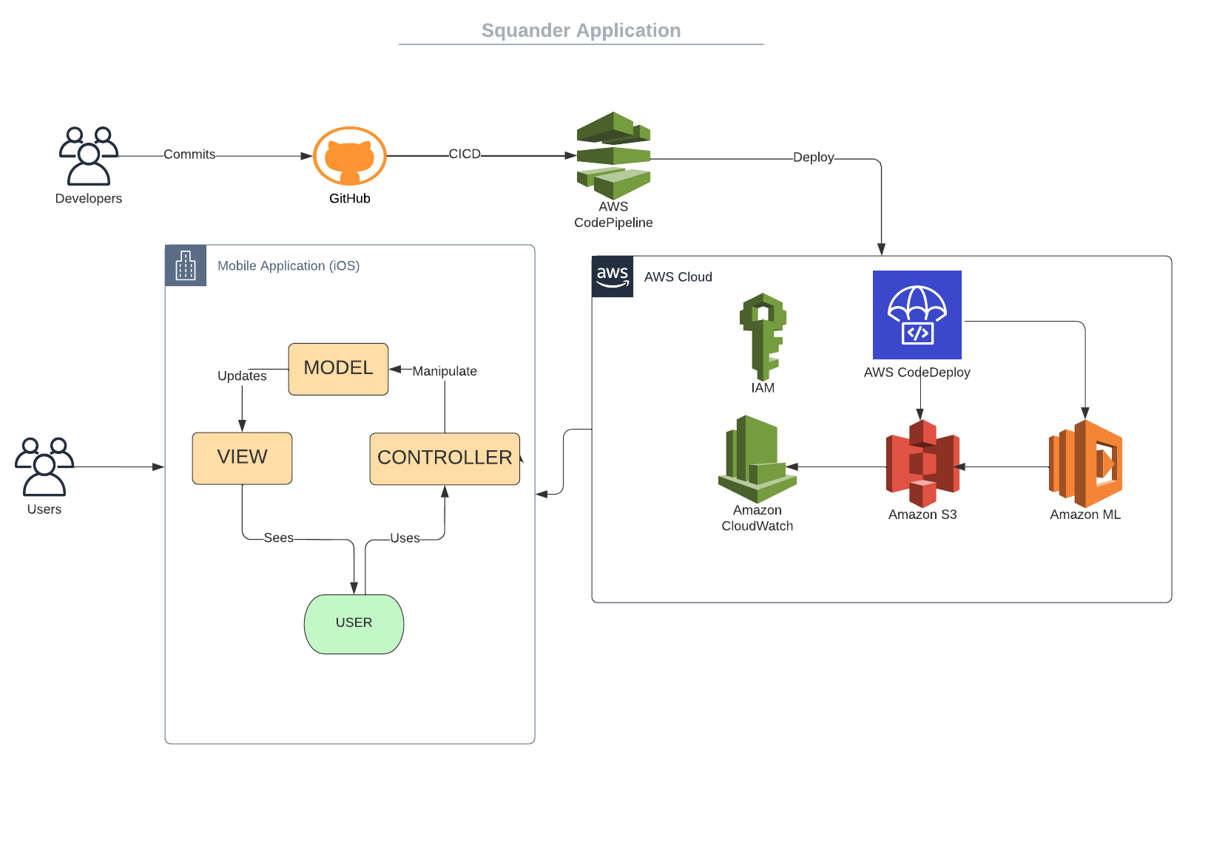
SQUANDER ARCHITECTURE
Notes:
Need to update it with a sequence diagram and flow diagram

Slide 18
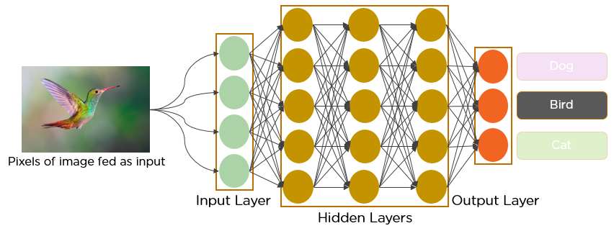
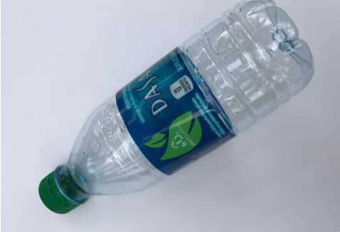
MACHINE LEARNING ALGORITHM
Plastic
Cardboard
Trash

Slide 19
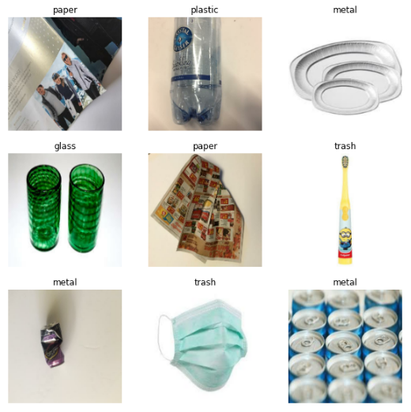
MODEL CLASSIFICATION
The model is able to classify trash into the following categories:
Cardboard
Glass
Metal
Paper
Plastic
Miscellaneous Trash

Slide 20
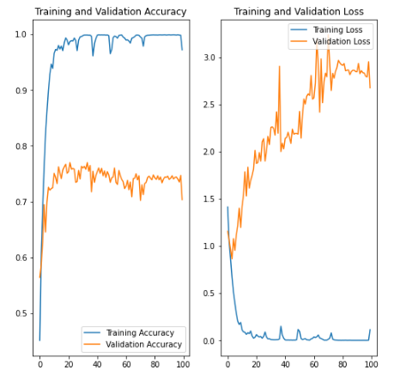
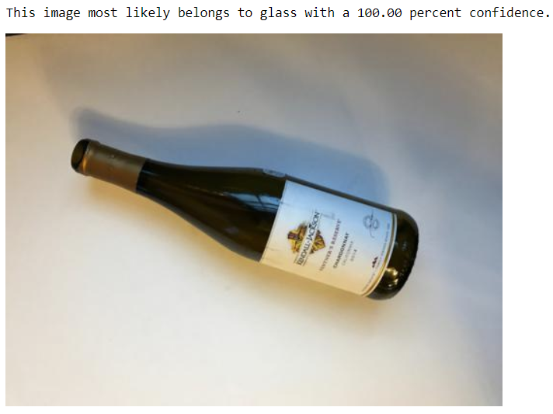
MODEL EVALUATION

Slide 21
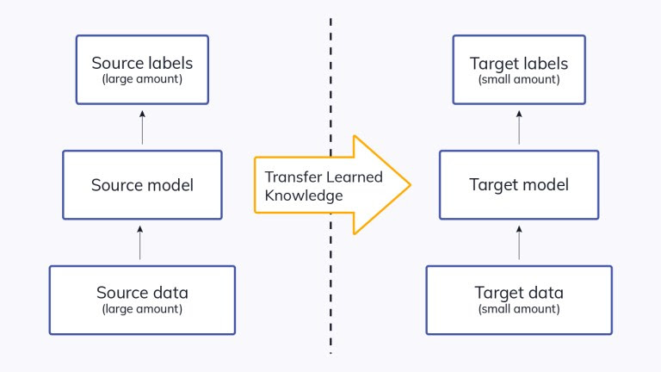
TRANSFER LEARNING
To alleviate the need for more images due to lack of public resources
Leverage a pre - trained model with a large amount of training data.
Fine tune the existing model.

Slide 22

SPRINT OVERVIEW

Slide 23
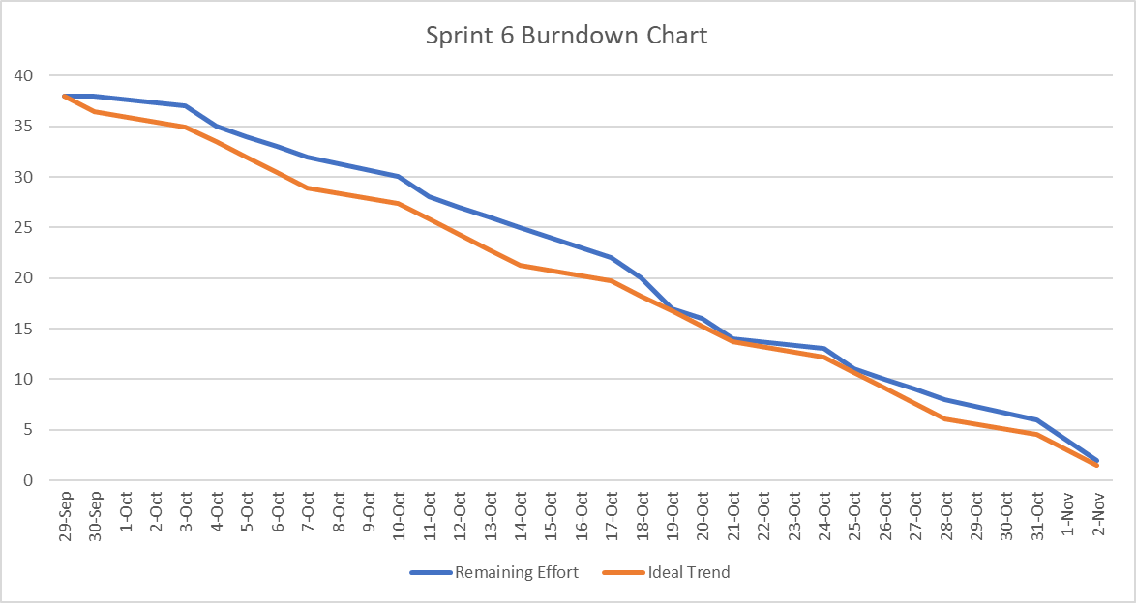
SPRINT VI RECAP
SPRINT 6 (09/29 - 11/2)
KEY | SUMMARY | PRIORITY | STATUS
SQD 61 | Improving the model accuracy | Medium | DONE
SQD 64 | As a retiree, David wants to Automatically load locations so that he can have a better user experience and easy to use application. | High | DONE
SQD 67 | As an engineer, John wants to view multiple recycling locations so that he can choose to navigate to one most accessible | HIgh | DONE
SQD 74 | As a mechanic, Simon wants to support a map view so that he can plan his route more intuitively | High | DONE
SQD 85 | Update GitHub and Wiki Page | Medium | DONE
SQD 86 | Update Technical Paper | Medium | DONE
SQD 87 | Create Deliverable 6 Presentation | Medium | DONE
SQD 88 | Create Deliverable 6 Pre-Recorded Video and Edit | Low | DONE
SQD 89 | Update Installation Manual and User Manual | Low | DONE
SQD 91 | Test Cases for Sprint 6 | Low | DONE
SQD 65 | As a homeowner, Mark wants to view details of the recycling location so that he can have a conversation with the company with any queries and know all the details of the working hour | High | In - Progress
Notes:
Aku will do it

Slide 24
SPRINT VI vs SPRINT VII
SPRINT VI | SPRINT VII
Recycling Location Feature is added | User Profiling
Map View of Recycling Location is added | UI/UX
Model confidence value improved from Sprint 6 | Multiple entity recognition
Automatically load all relevant recycling locations once the image is selected based on it waste type | FAQ Screen
Notes:
Aku

Slide 25
IMPROVEMENT FROM PROF FEEDBACK
Update the architectural design, like which component will work with which component. This architecture looks great, but needs one more in generic format. Professor showed us a diagram for that as well.
Updated it to be in more generic format
Can include Sequence Diagrams as well.
Included the sequence diagram
Retrospective: What went well can be still better. List all positive things into more simpler words.
Update the What went well part with the last sprint Future Action
Project Demo: Can have a separate video for Project Demo Link in our GitHub for easier use
A separate demo video is linked in our GitHub as well as provided the link in our presentation
Notes:
Aku

Slide 26

BACKLOG

Slide 27
PRODUCT BACKLOG
KEY | SUMMARY | PRIORITY | SPRINT | STATUS
SQD 62 | Working on Deploying and building the AWS Resource for Squander | Medium | Sprint 8 | TO DO
SQD 65 | As a homeowner, Mark wants to view details of the recycling location so that he can have a conversation with the company with any queries and know all the details of the working hour | High | Sprint6, Sprint 7 | DONE
SQD 66 | Design and Deploy AWS API Endpoint | Medium | Sprint 8 | TO DO
SQD 68 | Work on UI/UX and add more feature on Navigation Bar | Medium | Sprint 7 | DONE
SQD 72 | As a homeowner, Mark wants to know about the Frequently Ask Question screen so that he can get answers to some of the commonly ask question. | High | Sprint 7 | DONE
SQD 73 | As an engineer, John wants to schedule the pickup with the company so that he can be assured that his trash will be picked up. | High | Sprint 8 | TO DO
SQD 74 | As a mechanic, Simon wants to create his own account(User Profile) on Squander so that he can save his personal information like address, phone number, etc into the app for later use. | High | Sprint 7 | DONE
SQD 75 | Redesign the UI/UX | Low | Sprint 7 | DONE
SQD 76 | As a retiree, David wants to know his recycling statistics so that he knows how much he has contribution to saving the world from global warming | High | Sprint 8 | TO DO
SQD 80 | Optimize Squander Code | Medium | Sprint 8 | TO DO

Slide 28
SPRINT BACKLOG
SPRINT 7 (11/3 - 11/30)
KEY | SUMMARY | PRIORITY | STATUS
SQD 65 | As a homeowner, Mark wants to view details of the recycling location so that he can have a conversation with the company with any queries and know all the details of the working hour | High | DONE
SQD 68 | Work on UI/UX and add more feature on Navigation Bar | Medium | DONE
SQD 72 | As a homeowner, Mark wants to know about the Frequently Ask Question screen so that he can get answers to some of the commonly ask question. | High | DONE
SQD 74 | As a mechanic, Simon wants to create his own account(User Profile) on Squander so that he can save his personal information like address, phone number, etc into the app for later use. | High | DONE
SQD 75 | Redesign the UI/UX | Medium | DONE
SQD 99 | Update GitHub and Wiki Page and Technical Paper | Low | DONE
SQD 100 | Create Deliverable 7 Presentation | Medium | DONE
SQD 101 | Create Deliverable 7 Pre-Recorded Video and Edit | Medium | DONE
SQD 102 | Update Installation Manual and User Manual | Low | DONE
SQD 103 | Test Cases for Sprint 7 | Medium | DONE

Slide 29
USER STORIES & ACCEPTANCE CRITERIA
ID | AS A | I WANT TO | SO THAT | ACCEPTANCE CRITERIA
SQ 65 | Mark, the homeowner | View details of the recycling location | I could have a conversation with the location and form relations. | Given: Mark is able to view basic details of recycling location, When: He click on the Location, Then: He can have all the details of the company like address, working hours, etc.
SQ 72 | Mark, Home owner | FAQ Board | I easily get answered on common questions | Given: Mark have a common question When: Open the FAQ Page Then: Be able to view questions and answers.
SQ 74 | Simon, Mechanic | Have a profile Creation Page | I could save basic informations | Given: Simon needs to create a profile When: He updates information on Profile Page, Then: Be able to save the information for later use.
Notes:
Asutin

Slide 30

TEST CASES

Slide 31
TEST CASES
Test Case Name | User Story | Test Case ID | Test Action | Expected Results | Test Result | Pass/Fail
User Profiling | SQD-74 | SQD-109 | Locate the Splash Screen | User should be able to see the Splash Screen when you open the Squander application | Once the user opens the Squander app they are able to see the Splash screen | PASS
 |  | SQD-110 | Locate Proceed Button | User should be able to see the Proceed Button on the Splash Screen and it should be clickable | Once the user is on the Splash screen they are able to see the Proceed Button and it’s clickable. | PASS
 |  | SQD-111 | Locate the Login Page | User should be able to see the login Page with details for existing user as well as New User | Once the user click on Proceed Button, it takes us to the Login Page where existing as well as new users can login | PASS
 |  | SQD-112 | Locate SignUp Link | User should be able to click on the SignUp Link and a new Page should pop up where all details can be entered | Once the user click on SignUp Link, a new page pops up and all relevant data can be entered | PASS
 |  | SQD-113 | Locate Login Button | User should be able to see and click the Login Button | Once the user enter all the correct information and click on the Login Button its takes us to new page. | PASS
 |  | SQD-114 | Login the SIgnUp Button | User should be able to registered as a new user with all relevant details and click on SignUp Button | Once the user enter all the data for the new user and click on SignUp Button it is register as a user | PASS
 |  | SQD-115 | Locate the email and Password field | User should be able to locate the Email and Password field on Login Page | Once the user click on the Login Page and their we can see the email and password field | PASS
 |  | SQD-116 | Locate the Forgot Password Link | User should be able to view and click Forgot Password Link on Login Page | Once the user is on the Login Page there they can see the Forgot Password Link and when clicked it sends and email registered mail. | PASS
Notes:
Aku

Slide 32
TEST CASES (Continued)
Test Case Name | User Story | Test Case ID | Test Action | Expected Results | Test Result | Pass/Fail
Recycling details | SQD-65 | SQD-117 | Locate the Recycle Location Link | Users should be able to see the Recycle Location link and it should be clickable | Once the user is on the About Us Screen, the recycle location link is visible, and once clicked on the button it redirects to the recycle location | PASS
 |  | SQD-118 | Locate the Recycling Company | User should be able to view the details of the recycling company | Once the user is on the recycling page and it click on a company it will pop the details of the company. | PASS
 |  | SQD-119 | Nearby Recycling Location List | User should be able to see a list of recycling location in the screen | Once the user click on the Recycle button, users can see a list if nearby recycling Location | PASS
 |  | SQD-120 | Locate the Back Button | User should be able to see the Back Button in the result screen | Once the user is on the Result Screen, the back button is visible, and once clicked on the button it redirects to the home screen | PASS
FAQ Screen | SQD-72 | SQD-121 | Locate the FAQ on Nav Bar | User should be able to view the FAQ Link in the Nav Bar | Once the user click on the Nav bar a FAQ Link is visible and Clickable | PASS
 |  | SQD-122 | Click the FAQ Link | User should be able to click the FAQ Link and a new page should open | Once the user click on the FAQ Link a new page Open up | PASS
 |  | SQD-123 | Locate all FAQ on the PAge | User should be able to view the all frequently asked question on the page | Once the user is on th FAQ Page all the frequently and most asked question are already answered and can help the user to get a resolution quickly | PASS
Notes:
Aku

Slide 33
STORIES COMPLETED
ID | AS A | I WANT TO | SO THAT | ACCEPTANCE CRITERIA
SQ 65 | Mark, the homeowner | View details of the recycling location | I could have a conversation with the location and form relations. | Given: Mark is able to view basic details of recycling location, When: He click on the Location, Then: He can have all the details of the company like address, working hours, etc.
SQ 72 | Mark, Home owner | FAQ Board | I easily get answered on common questions | Given: Mark have a common question When: Open the FAQ Page Then: Be able to view questions and answers.
SQ 74 | Simon, Mechanic | Have a profile Creation Page | I could save basic informations | Given: Simon needs to create a profile When: He updates information on Profile Page, Then: Be able to save the information for later use.

Slide 34
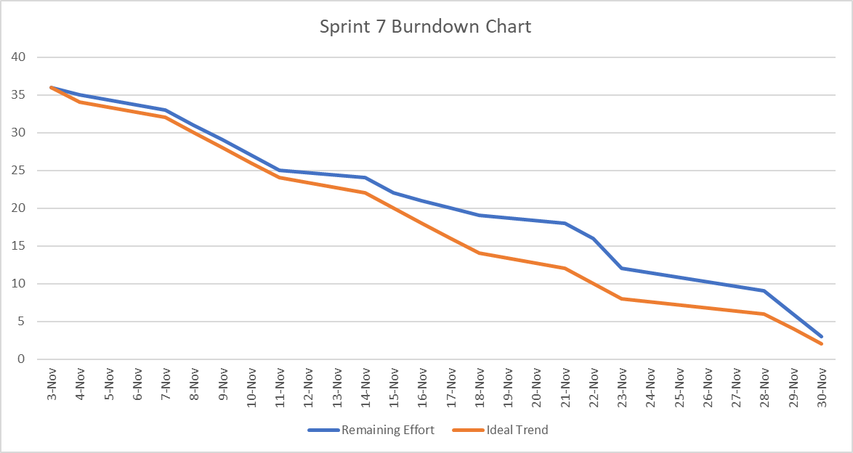
BURNDOWN CHART

Slide 35
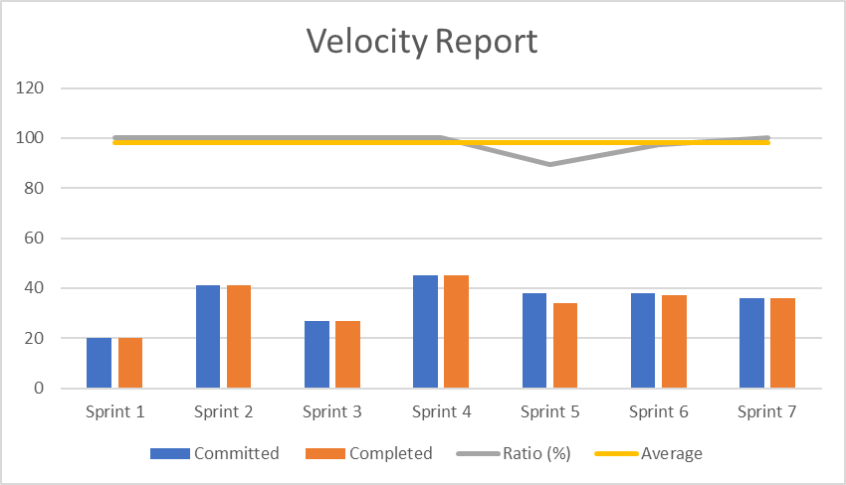
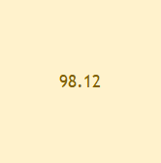
COMMITTED/COMPLETED RATIO
SPRINT | Committed | Completed | Ratio (%) | Average
Sprint 1 | 20 | 20 | 100 | 98.12
Sprint 2 | 41 | 41 | 100 | 98.12
Sprint 3 | 27 | 27 | 100 | 98.12
Sprint 4 | 45 | 45 | 100 | 98.12
Sprint 5 | 38 | 34 | 89.47368421 | 98.12
Sprint 6 | 38 | 37 | 97.36842105 | 98.12
Sprint 7 | 36 | 36 | 100 | 98.12
Current Committed Completed Ratio (Sprint 7) = 100%

Slide 36

RETROSPECTIVE

Slide 37
RETROSPECTIVE
01
What went well
Regular Sprint Meeting
Sprint Estimation
02
What needs improvement
Buffer Time Estimation
Support team involvement
03
Future Actions
Estimate the Buffer Time into the Sprint Velocity
Encourage team involvement by helping each other

Slide 38

FUTURE SPRINT

Slide 39
SPRINT VIII(LAST SPRINT)
SPRINT 8 (12/1 - 12/15)
KEY | SUMMARY | PRIORITY | STATUS
SQD 65 | Working on Deploying and building the AWS Resource for Squander | High | TO DO
SQD 68 | Design and Deploy AWS API Endpoint | Medium | TO DO
SQD 72 | As an engineer, John wants to schedule the pickup with the company so that he can be assured that his trash will be picked up. | High | TO DO
SQD 74 | As a retiree, David wants to know his recycling statistics so that he knows how much he has contribution to saving the world from global warming | High | TO DO
SQD 75 | Optimize Squander Code | Low | TO DO
SQD 104 | Update GitHub and Wiki Page and Technical Paper | Medium | TO DO
SQD 105 | Create Deliverable 8 Presentation | Medium | TO DO
SQD 106 | Create Deliverable 8 Pre-Recorded Video and Edit | Medium | TO DO
SQD 107 | Update Installation Manual and User Manual | Medium | TO DO
SQD 108 | Test Cases for Sprint 8 | Medium | TO DO

Slide 40
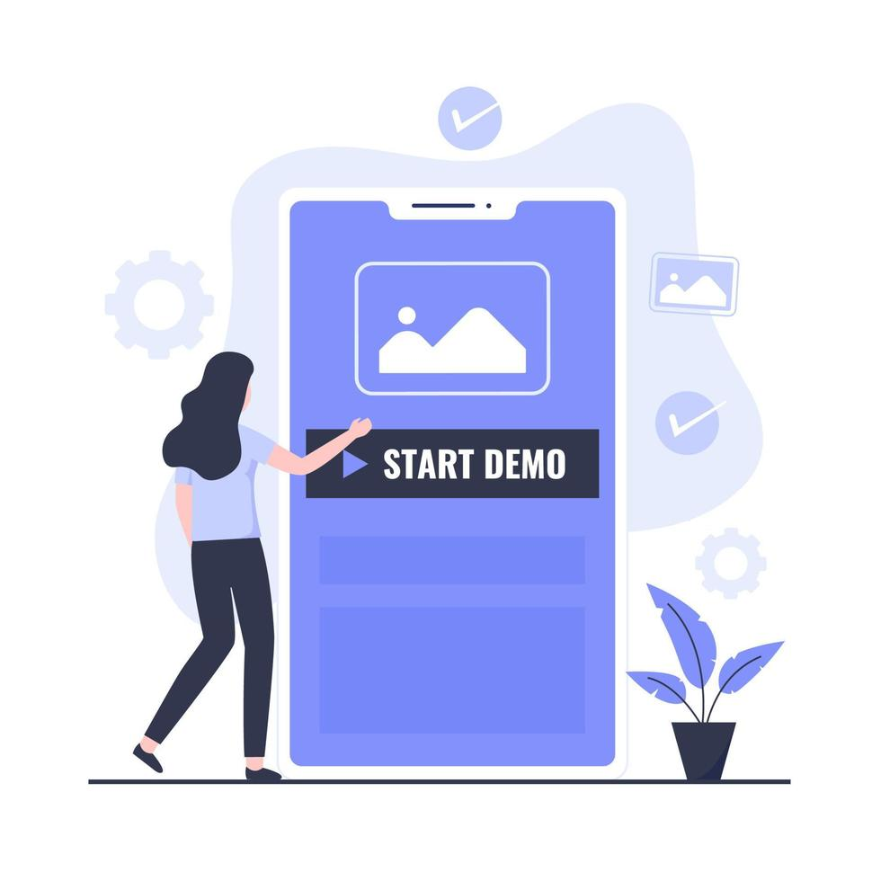
PROJECT DEMO

Slide 41
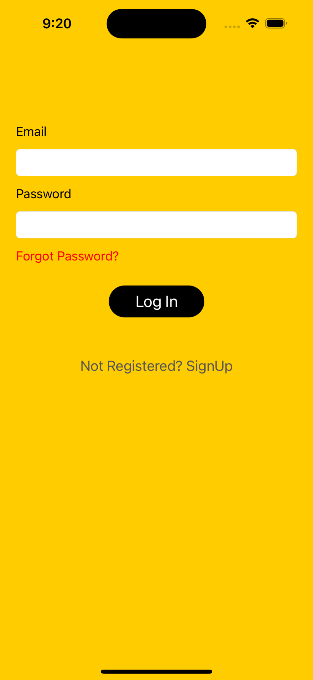
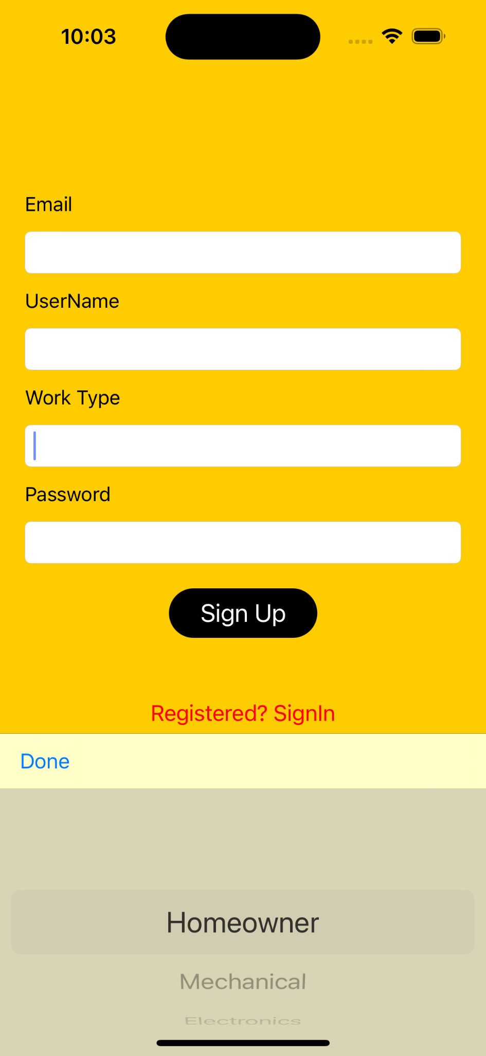
APP SCREENSHOTS
Login and Signup
For registered user it allows to logIn with username and password.
If it is new user it allows to register via
signUp with email,username,worktype,
password.

Slide 42
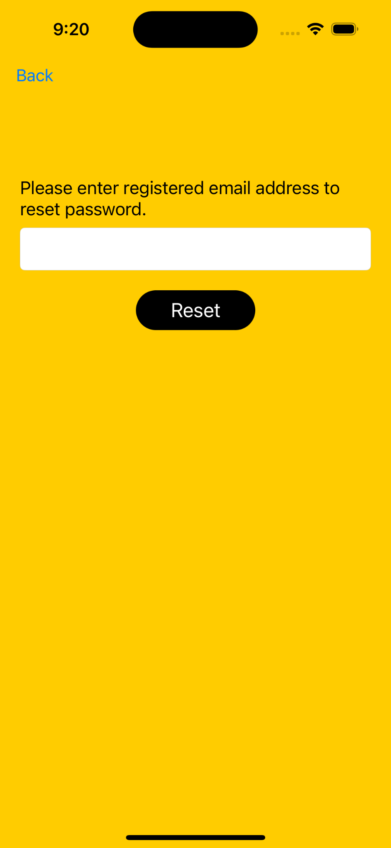
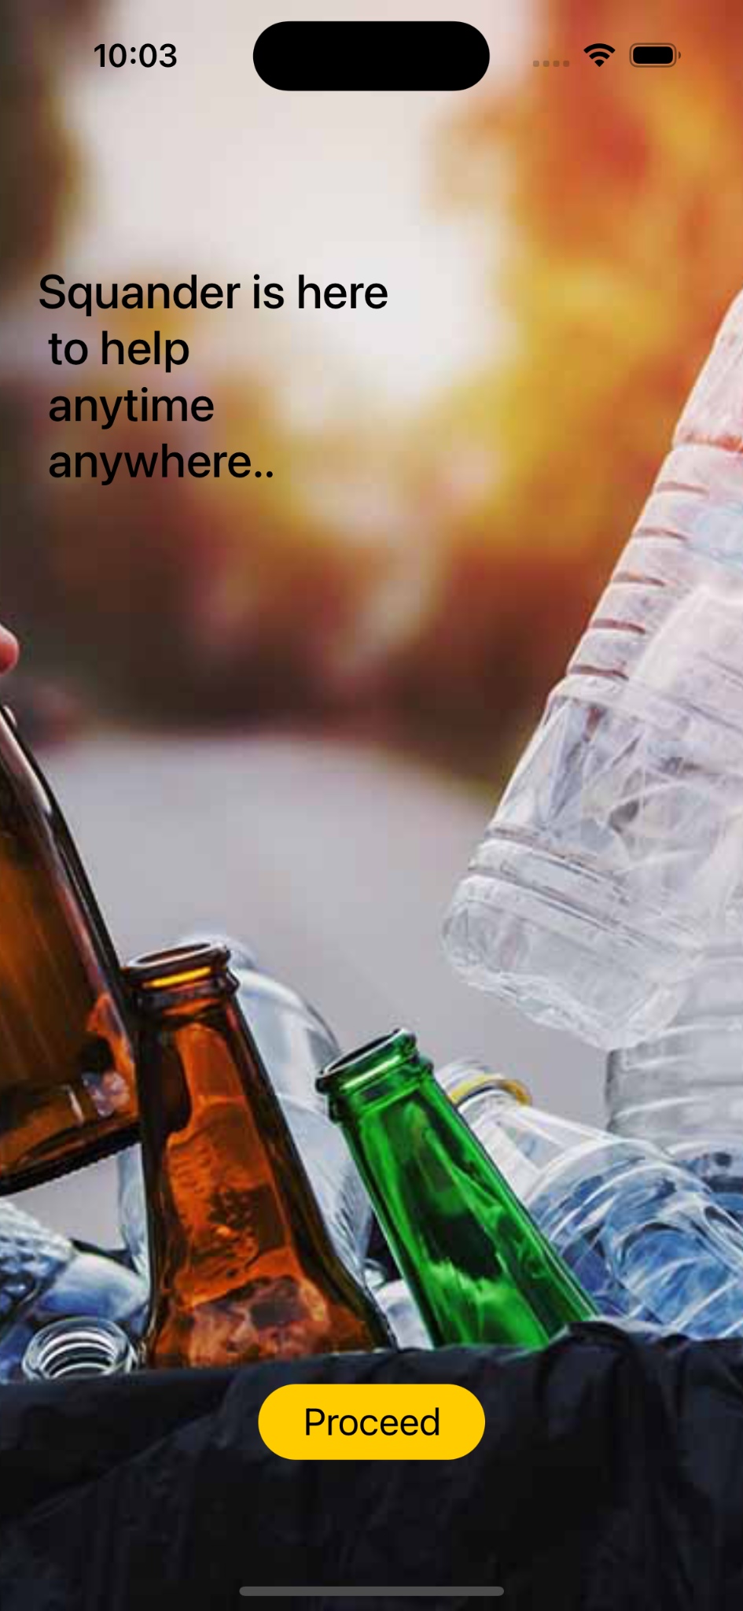
APP SCREENSHOTS (Continued)
Reset Password and Splash Screen
If user wants to reset his password he can type email address so that password reset link is sent.
When a new user opens app for the first time user is navigated to splash Screen.
Once Proceed is clicked user is navigated to login screen.

Slide 43
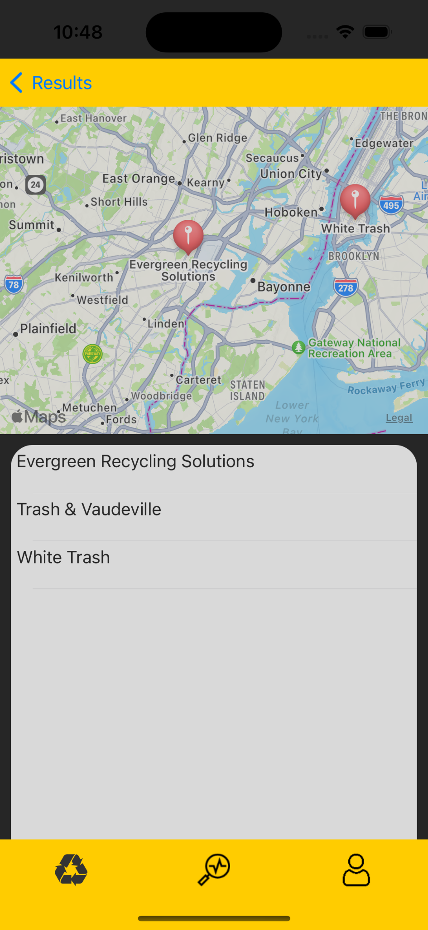
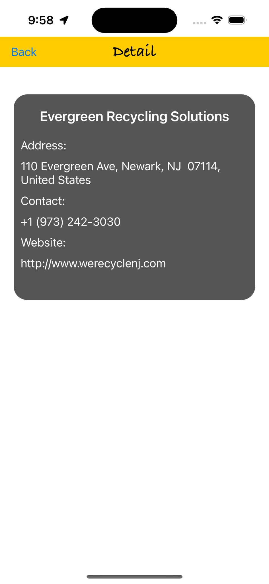
APP SCREENSHOTS (Continued)
Detail Screen
On the recycling Location Screen user gets list of recycling locations for particular item.
If user clicks on any location then he is navigated to detail screen
which shows name,address,
contact and website of recycling company.

Slide 44
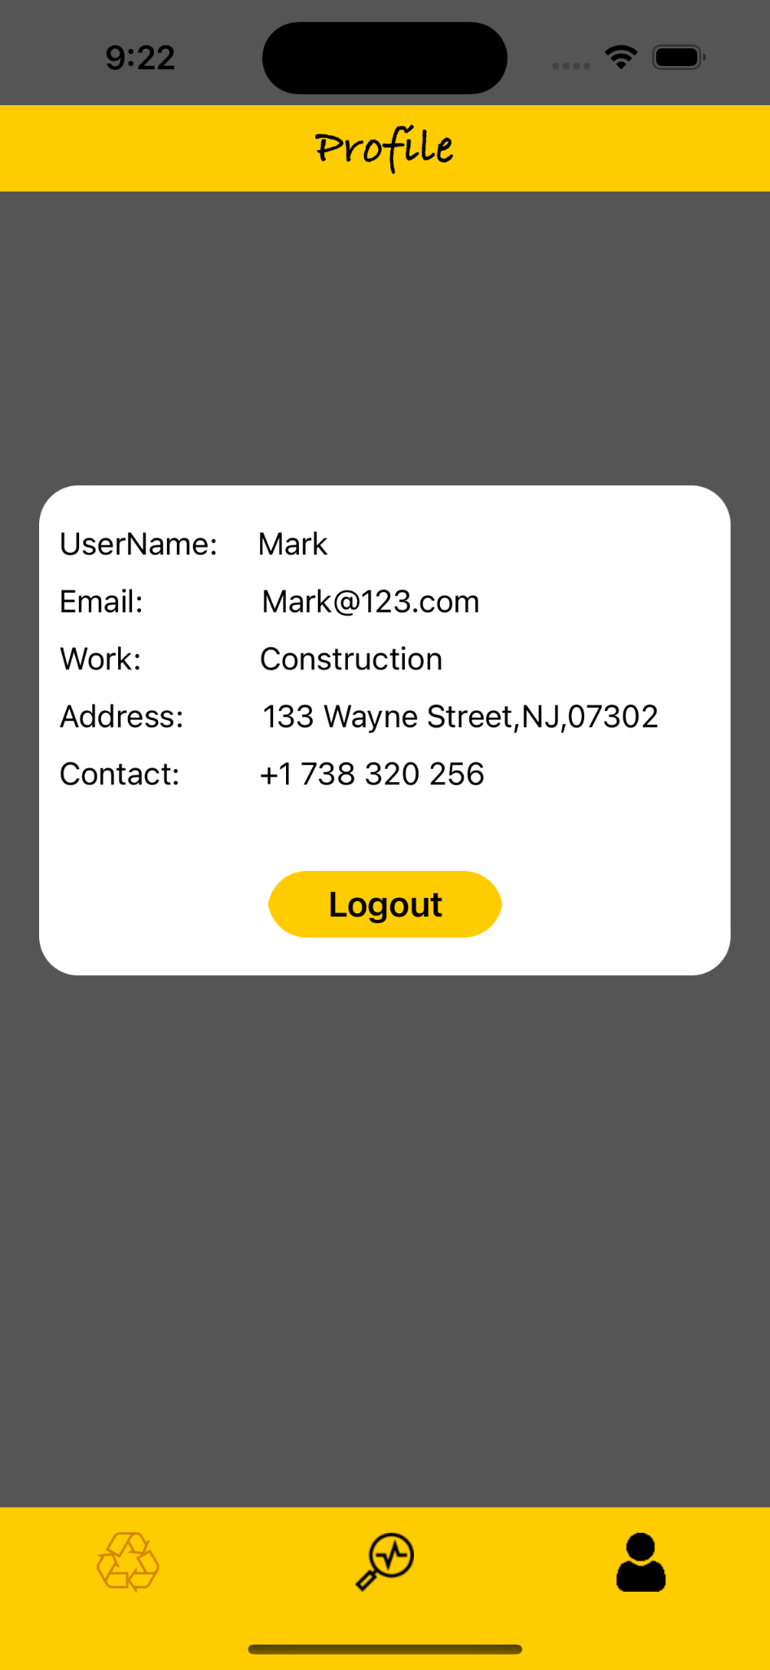
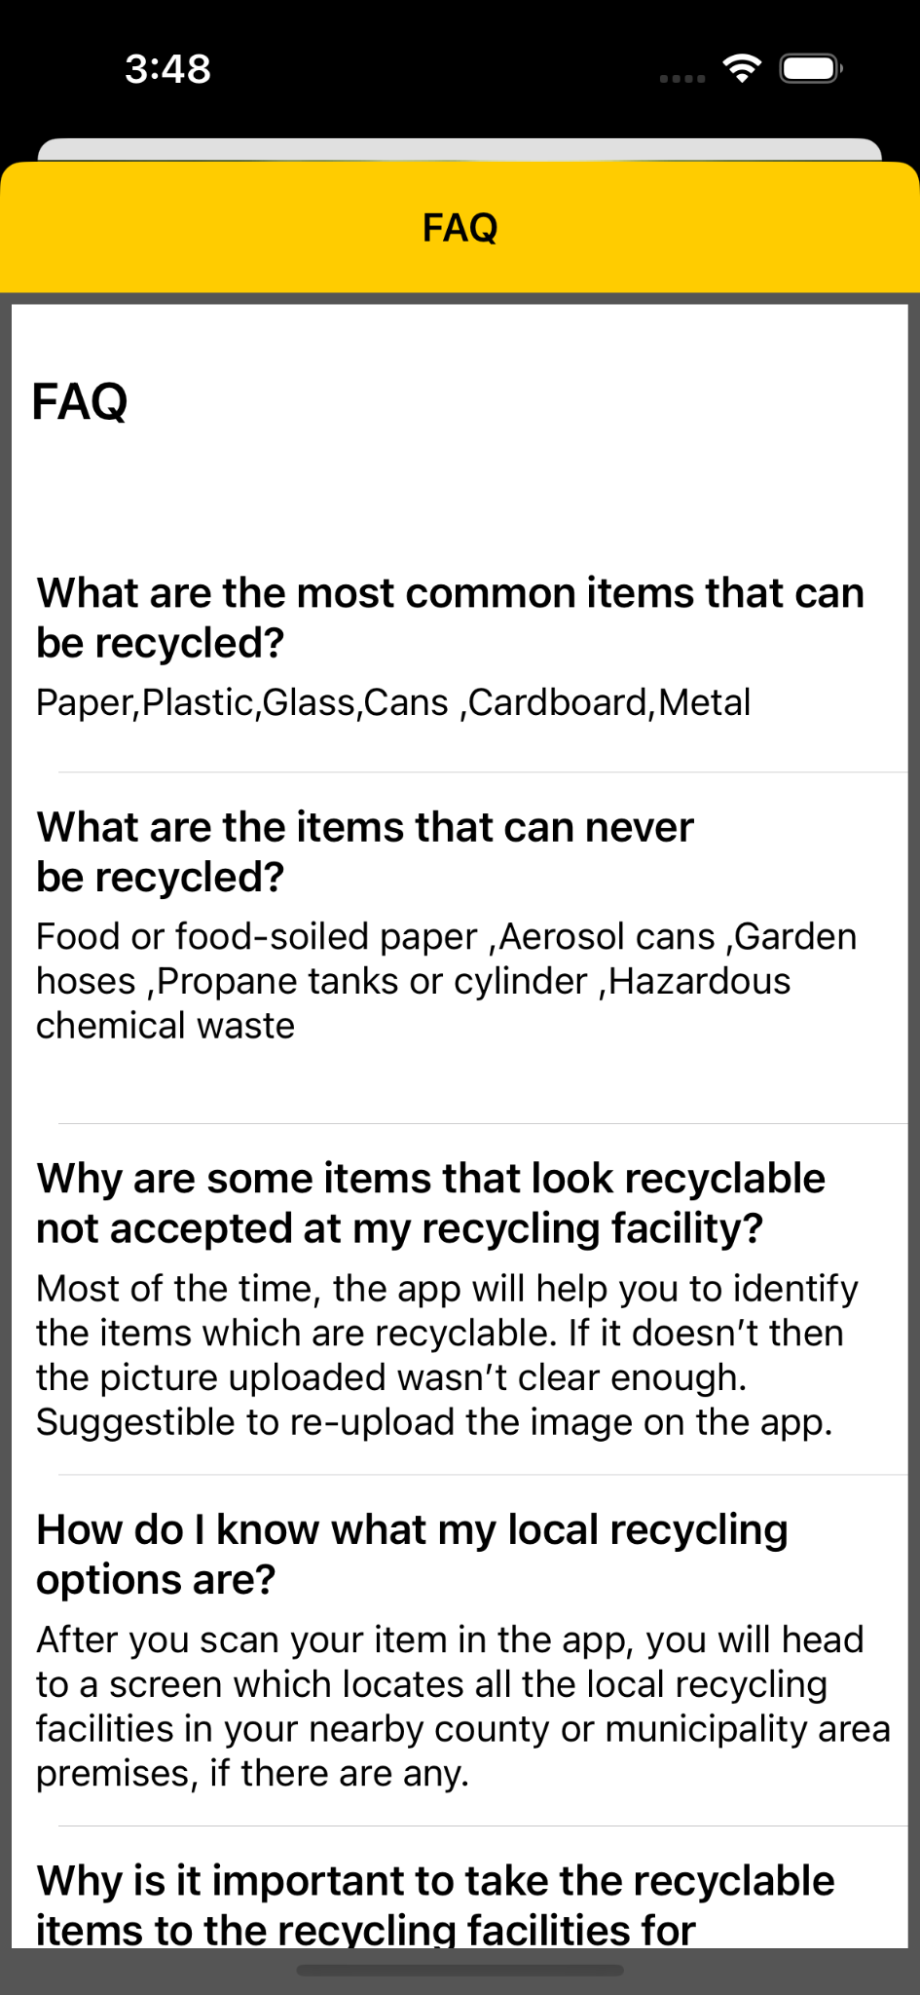
APP SCREENSHOTS (Continued)
Profile and FAQ
On the profile screen user can see name,email,work address and contact.
FAQ screen shows list of frequently asked questions about how to use app.

Slide 45


API
MapKit API
Core Location API

Slide 46

GITHUB LINK
GitHub: https://github.com/anku518/Squander/wiki

Slide 47
THANK YOU!!!

